Slide 1



Essentials Of Software Development - QAP
By: Justin Greenslade

Slide 2

Lesson 1: Three Common computer components

Slide 3
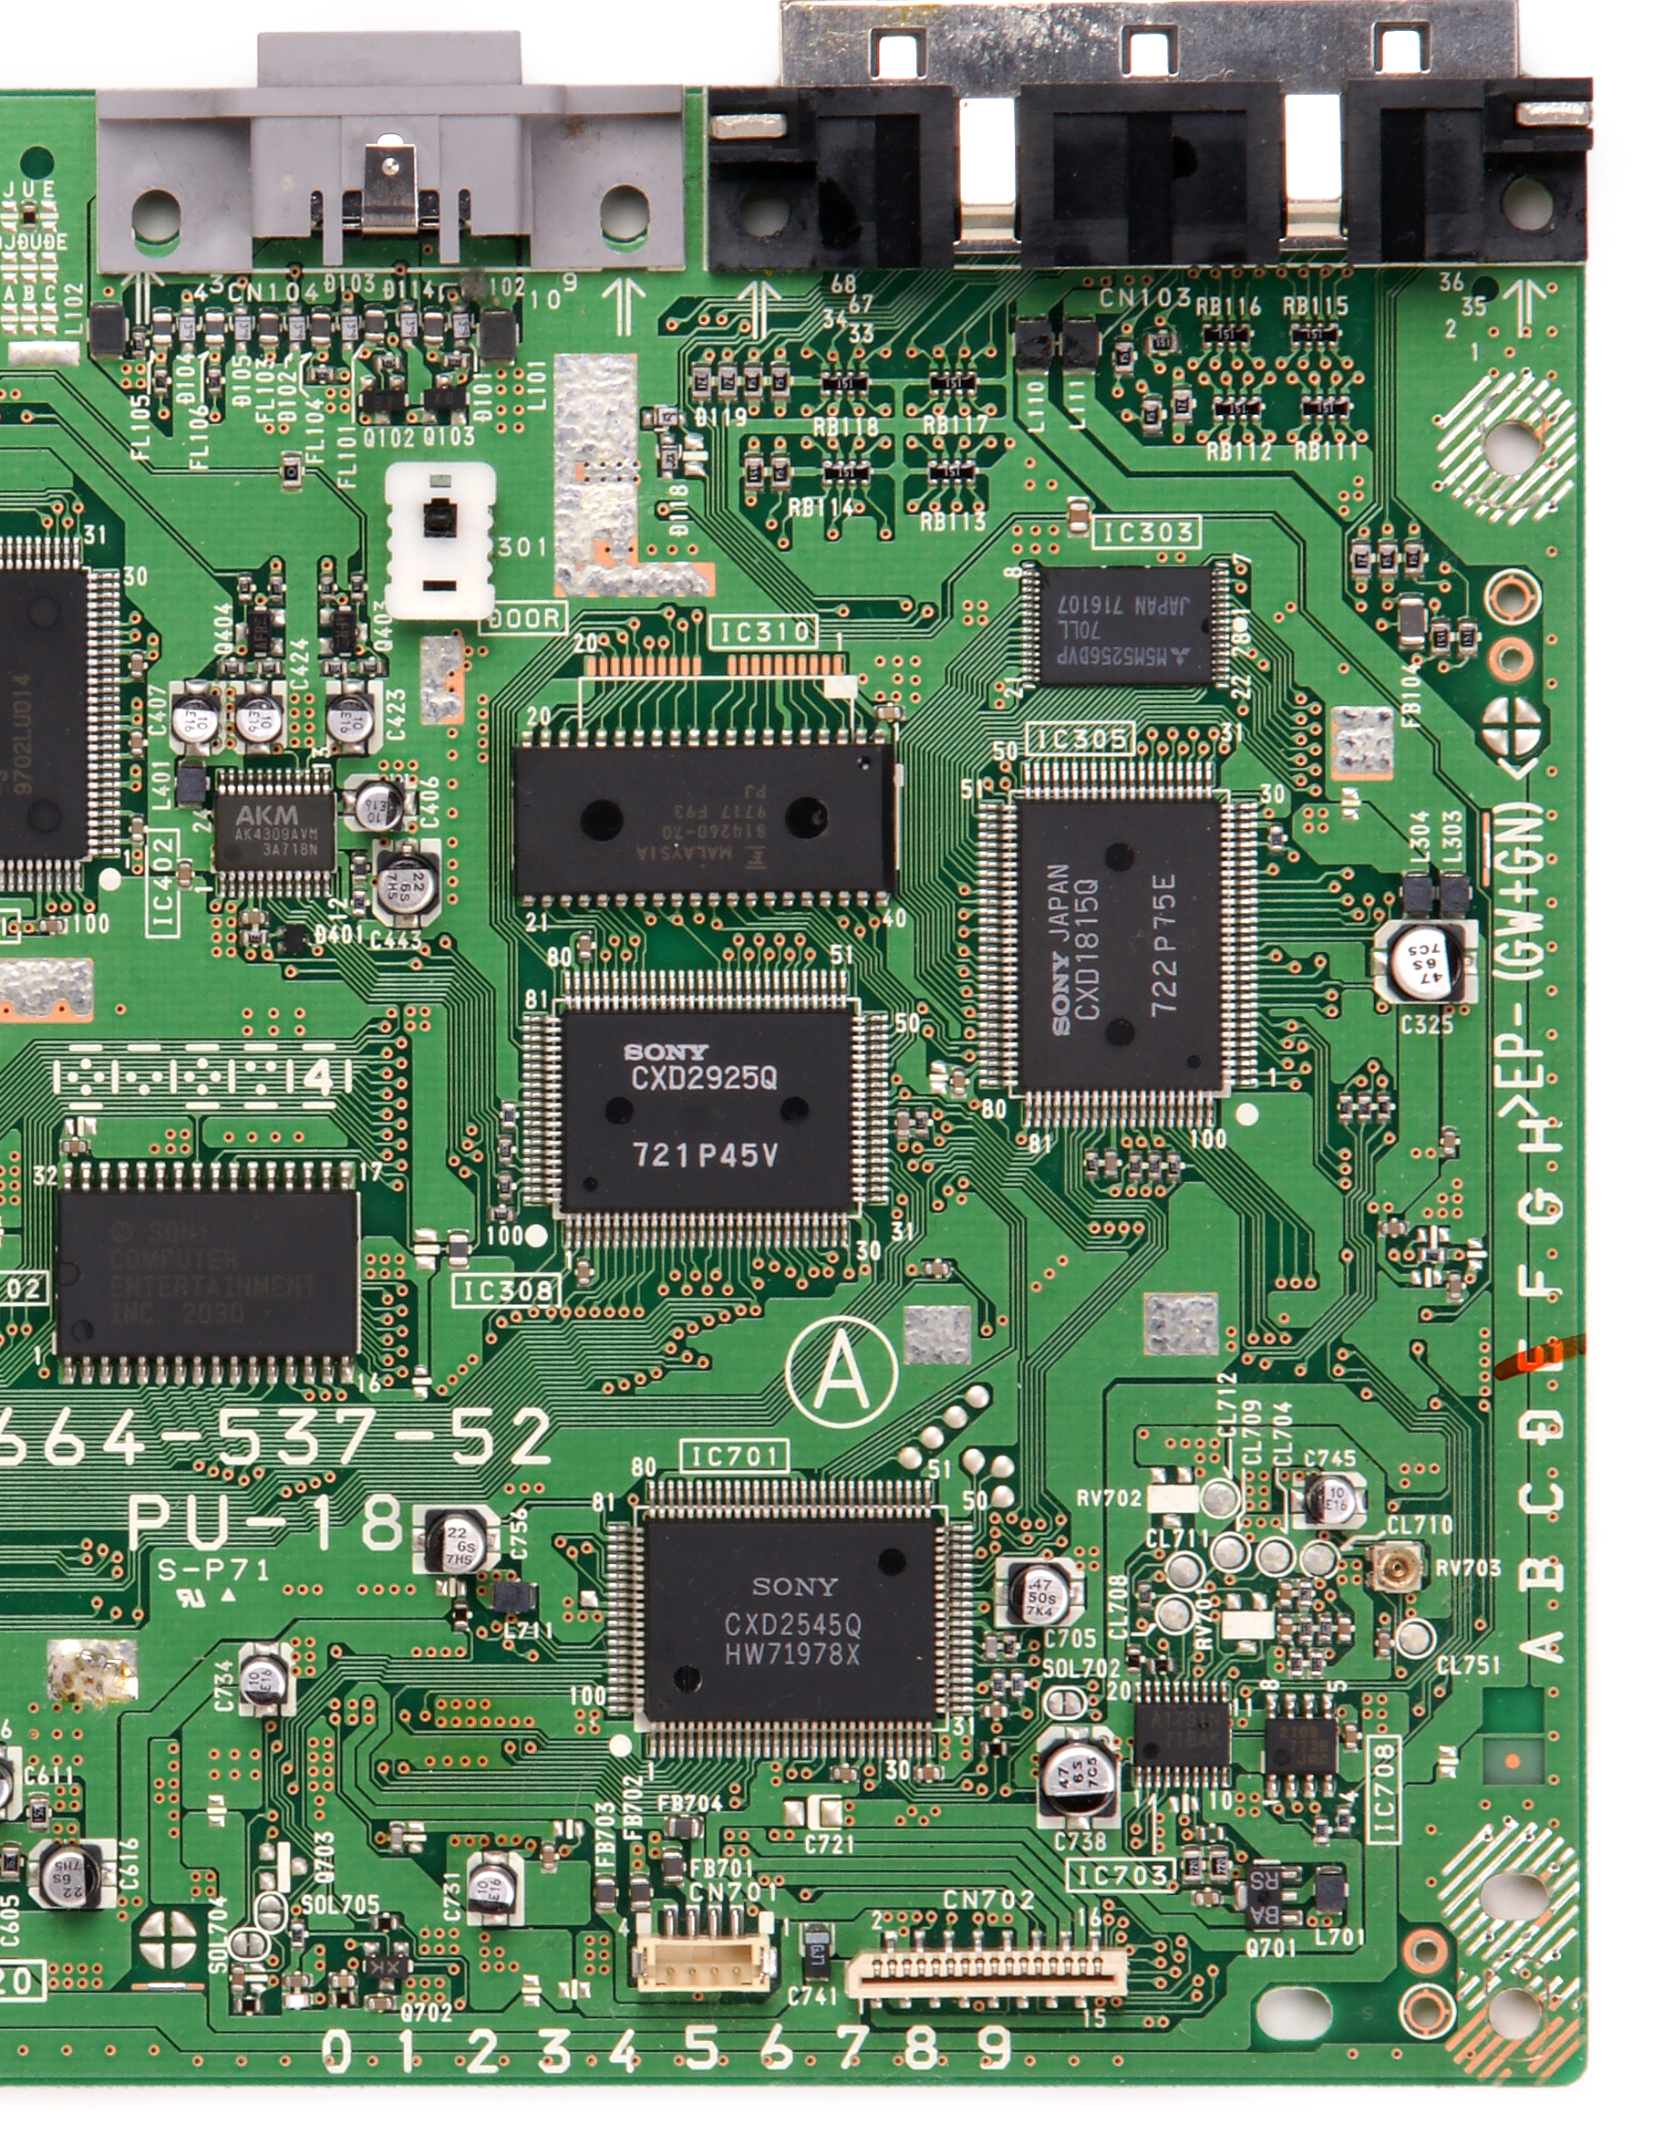
Motherboard
1
The Motherboard is the main circuit board in a computer
It connects and allows communication between the CPU, RAM, Storage, and Peripherals.
They come in different sizes affecting compatibility with cases and expansion options

Slide 4
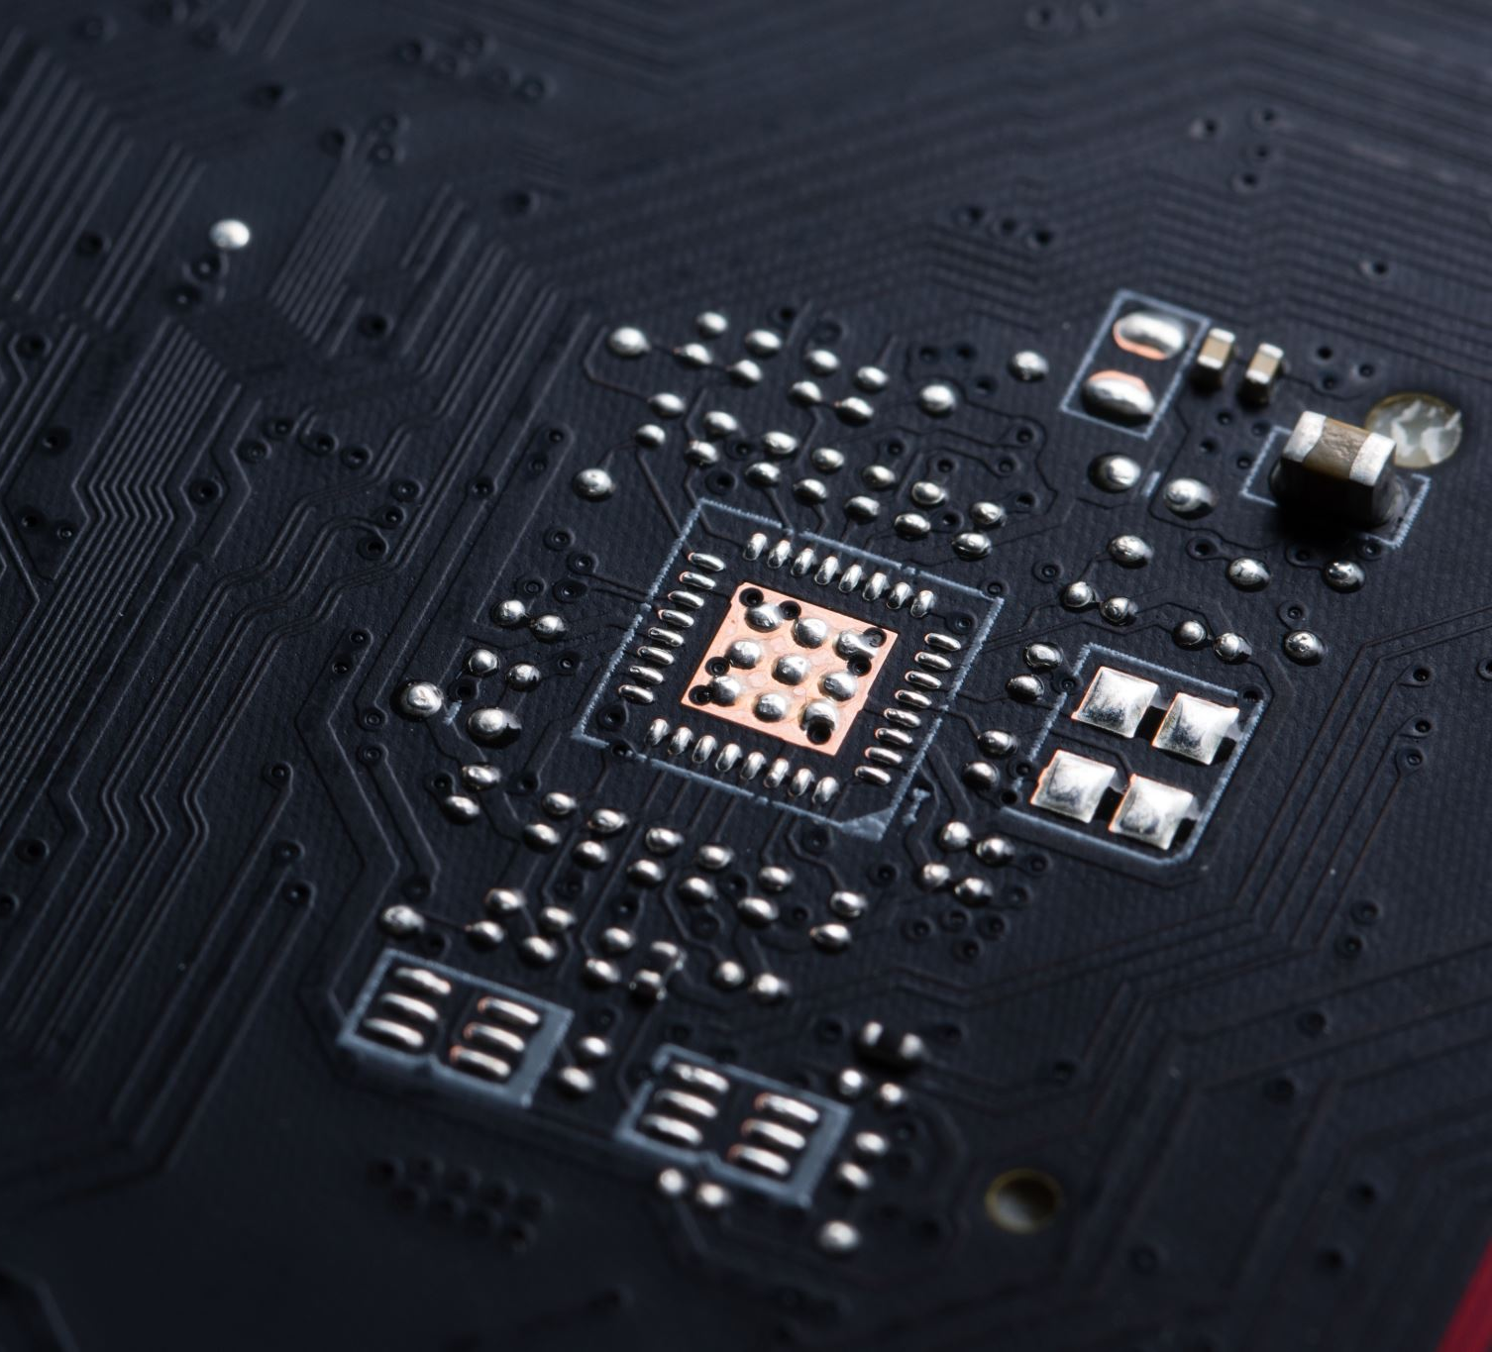
CPU (Central Processing Unit)
The CPU is the main processor in a computer, often called the “brain” of the system
It executes instructions and preforms calculations to run programs and processes.
Modern CPUs can have multiple cores, allowing them to handle several tasks simultaneously and improve overall performance.

Slide 5
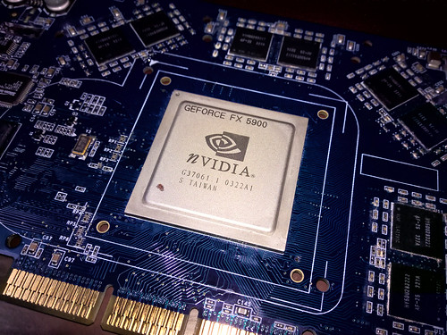
GPU (Graphics processing unit)
2
A GPU is a specialized processor designed for rendering graphics and handling visual tasks.
Accelerates the creation of images, videos, and animations, improving visual performance and quality.
GPUs are also used for parallel processing tasks beyond graphics, such as data analysis and machine learning

Slide 6

Lesson 2: Time-Line History

Slide 7
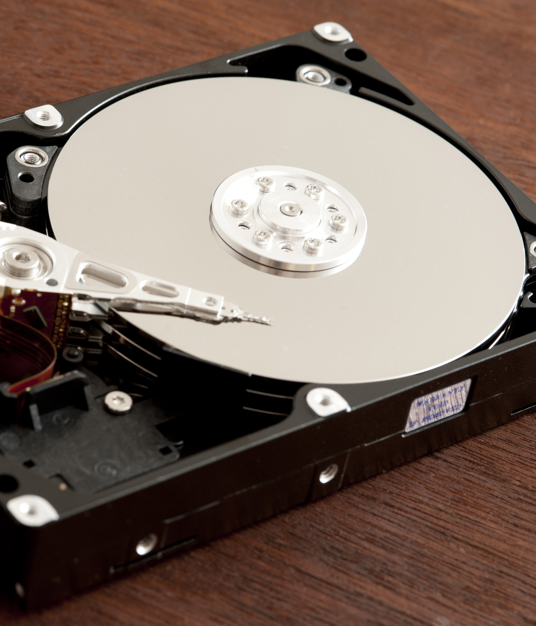
Hard Drive The Ramac (1956-1957)
3
The Hard Drive Introduced in 1956 with widespread availability in 1957
It was the first hard disk drive, marking a major advancement in data storage technology.
It featured 50 24-inch disks, with a total capacity of 5 MB (The size of two refrigerators)
It cost about $10,000 per megabyte of storage.

Slide 8
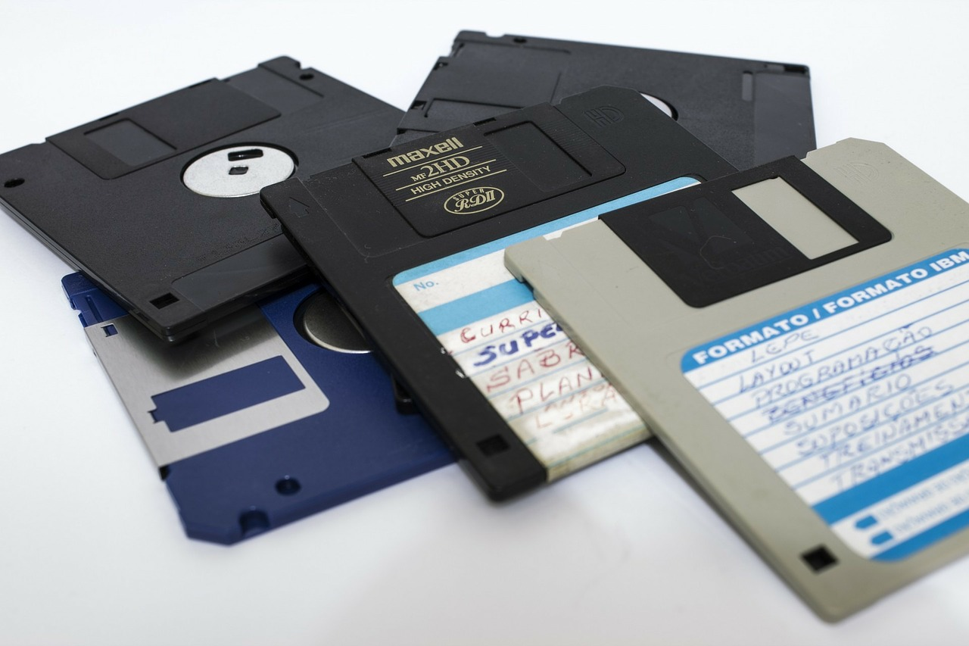
Floppy Disk (1971)
4
The Floppy Disk was Introduced in 1971.
Provided a portable, easy-to-use method for data storage and transfer, replacing earlier methods like magnetic tapes.
Developed by IBM, the original floppy disk was 8 inches in size and could store about 80 KB of data.
The term "floppy" comes from the disk's flexible, magnetic coating, which allowed it to be bent and flexed.

Slide 9

World wide web (1991)
5
The World wide web was Introduced in 1991
Revolutionized how information is accessed and shared globally, leading to the development of the modern internet.
Created by Tim Berners-Lee, it provided a system for linking hypertext documents over the internet, making information easily accessible via web browsers.
The first website was hosted on a NeXT computer, which was also the first web server.

Slide 10

Lesson 3: Catastrophic computer failures

Slide 11
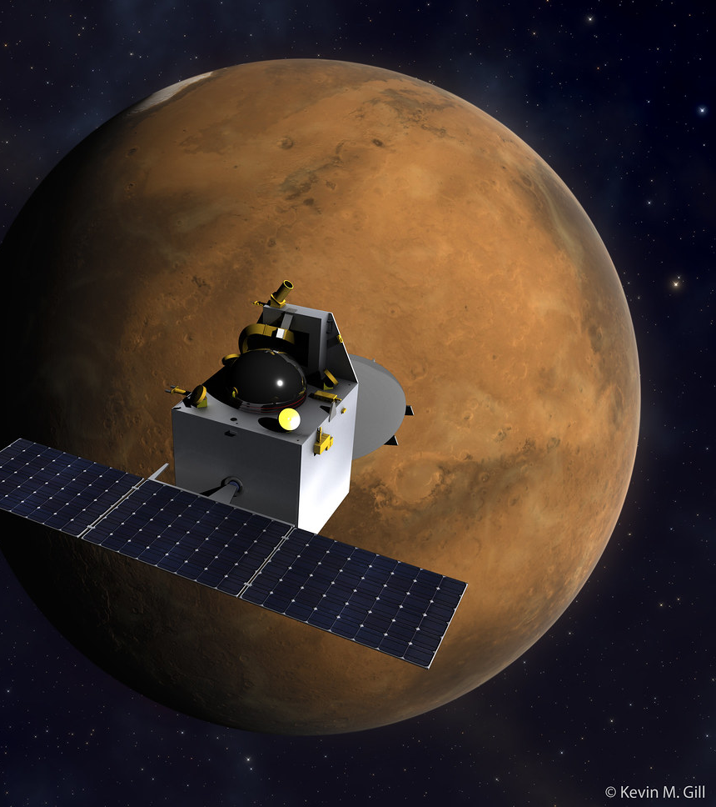
Mars Climate Orbiter (1999)
6
The event was called “The Mars Climate Orbiter Mission”.
This event caused the Loss of the spacecraft and came to a total loss of $327 million.
This could have been prevented by using a consistent measurement system and improving cross team communications.
This event led to better mission standards at NASA.

Slide 12
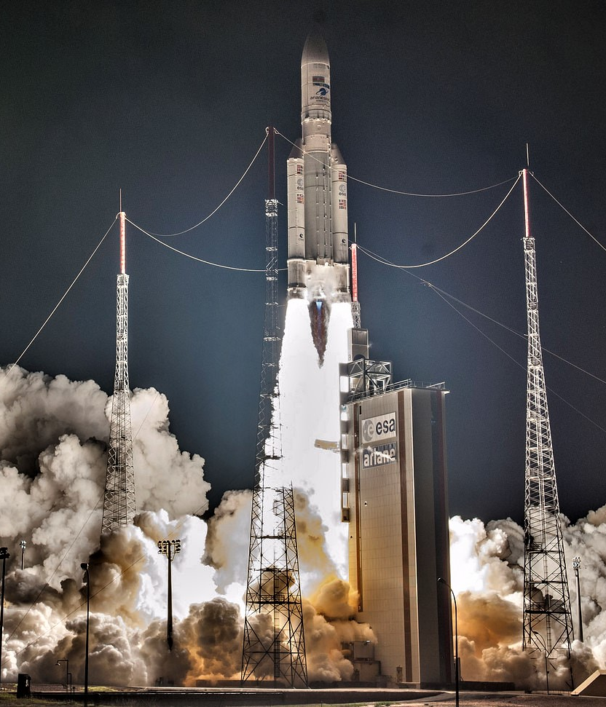
Ariane 5 (1996)
7
The event is the First flight of the Ariane 5 Rocket.
This event caused the rocket to explode and caused a $370 million loss.
This could have been prevented by updating the software for the new rocket specs, along with thorough testing.
It became one of the most reliable rockets after the initial failure.

Slide 13
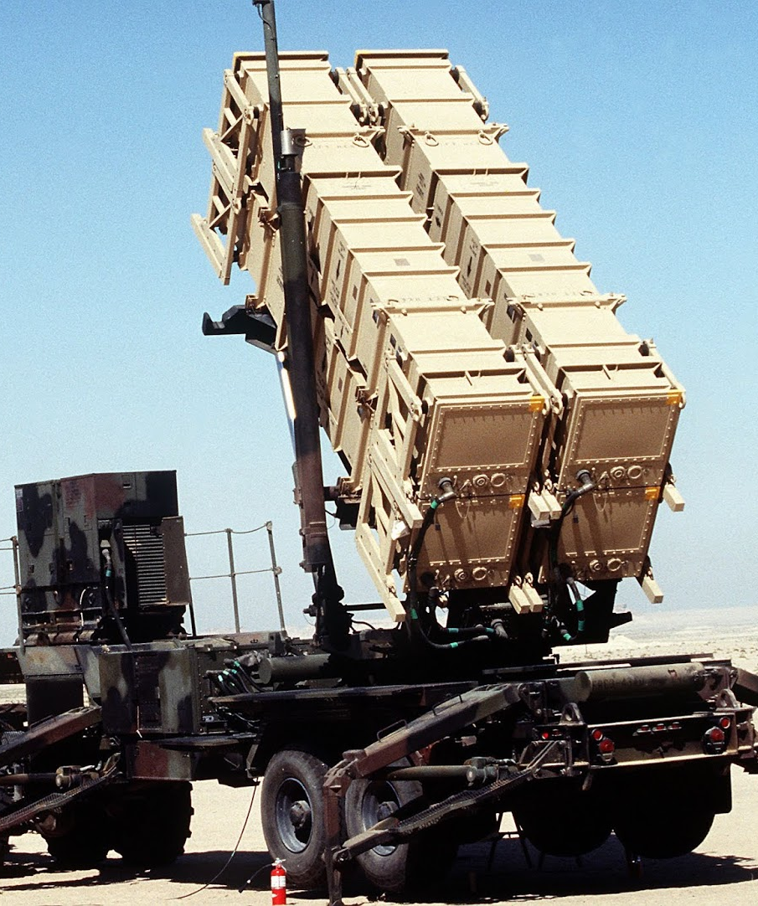
Dhahran Patriot Missile Interception (1991)
8
This event was the failure of Patriot Missile System in the Gulf War.
Resulted in 28 soldiers killed, exposing system vulnerabilities.
Could have been prevented with regular system reboots and clock synchronization.
This even highlighted the need for accurate timekeeping in missile defense.

Slide 14

Lesson 4: Career Technical Briefing

Slide 15

Cloud Engineer
9
This job might also be referred to as a Cloud Engineer, Cloud Solutions Architect, or a Cloud Systems Engineer
Design and deploy cloud infrastructure.
Monitor cloud performance and troubleshoot issues.
Manage cloud security and optimize costs.
There is a strong demand with the rise of cloud technology.
Salary average $106k per year

Slide 16

Data Scientist
10
This job might also be referred to as a Data Scientist, Data Analyst, Analytics Consultant
Analyze and interpret large datasets.
Develop predictive models and data visualizations.
Provide actionable insights and recommendations.
There is a high demand for data-driven decision-making.
Salary average $113k per year

Slide 17
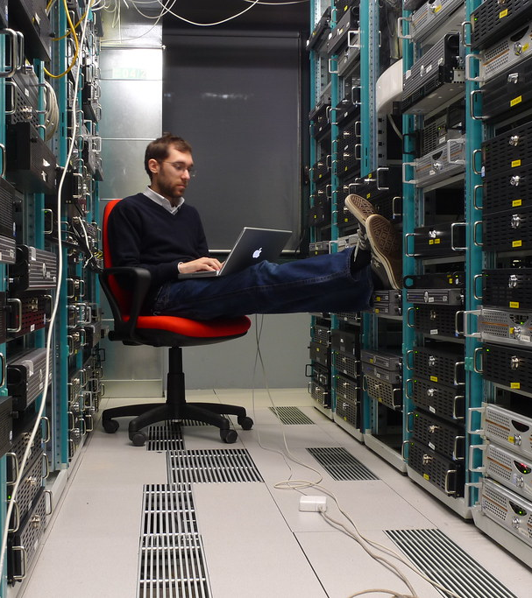
Computer Network Architect
11
This job might also be referred to as a Network Architect, Network Engineer, IT Network Architect
Design and build data communications networks.
Optimize network performance and ensure security.
Troubleshoot and resolve network issues.
There is a growing need for sophisticated network solutions.
Salary average $120k per year

Slide 18

Lesson 4: Every programmer should know

Slide 19
Text Editors
Text editors are tools used by developers for writing and editing code. They provide user-friendly interfaces to work with code, configure syntax, highlighting, and support various programming languages.
Some basic editors are: Notepad and TextEdit
Some more advanced editors are: Notepad++, Sublime Text, and VS Code

Slide 20
Sources Part:1
Picture number 1: https://upload.wikimedia.org/wikipedia/commons/d/d7/PSX-SCPH-5001-Motherboard.jpg
Picture number 2: https://live.staticflickr.com/4614/27830149309_78608bd74a.jpg
Picture number 3: https://www.freeimageslive.co.uk/files/images010/open_hard_disk.jpg
Picture number 4: https://s3-us-west-2.amazonaws.com/courses-images-archive-read-only/wp-content/uploads/sites/746/2015/08/23082121/floppy-disk-214975_1280.jpg
Picture number 5: https://pixabay.com/static/uploads/photo/2015/09/16/08/55/online-942405_960_720.jpg

Slide 21
Sources part: 2
Picture number 6: https://live.staticflickr.com/3936/15237158879_09206e8628_b.jpg
Picture number 7: https://www.astroblogs.nl/wp-content/uploads/2018/09/Ariane-5-100th-successful-launch-VA243-CNES.jpg
Picture number 8: https://blog.keliweb.it/wp-content/uploads/2014/11/Cloud_Computing.jpg
Picture number 9: https://blog.keliweb.it/wp-content/uploads/2014/11/Cloud_Computing.jpg
Picture number 10: https://cdn.careeronestop.org/OccVids/OccupationVideos/15-1111.00.jpg
Picture number 11: https://c1.staticflickr.com/3/2775/4381851322_d46fd7d75e_b.jpg

